Slide 1
Adobe Marketo Engage and Marketo Measure
July and Sept 2023 Release Updates

Slide 2
March and May 23 Release Highlights
ADOBE MARKETO ENGAGE AND MARKETO MEASURE
  Scale Marketing
  Teams
  Reimagine Marketing & Sales Partnership
  Maximize Revenue Impact
Modern UX Updates (complete switch to modern UX, Used By Count for List Views, Used By Tabs for Detail Views)
Interactive Webinars User Access Management and Localization
Engagement Map
available NOW!
Dynamic Chat enhancements- GA Sept 12!
Sales Insight Actions- Email Personalization
Marketo Measure Ultimate (powered by Experience Platform) – available NOW!
©2023 Adobe. All Rights Reserved.

Slide 3







Meet the Team
Nilesh Dalvi
Sr. Product Manager
John Dictson
Sr. Product Manager
Steven Vanderberg
Sr. Product Manager
Tina Tseng
Product Manager
Lopa Padia
Product Manager
Andy Paul
Sr. Product Manager
Brian Shin
Product Manager

Slide 4



Marketo Engage Modern UX and Interactive Webinars
Nilesh Dalvi
Senior Product Manager

Slide 5
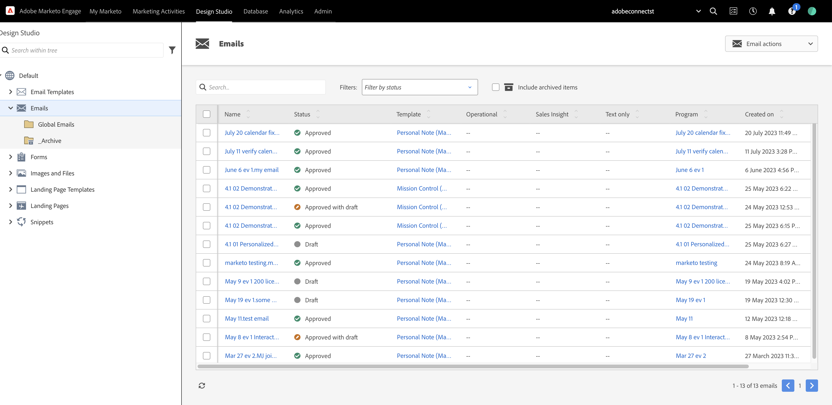
Modern UX: Classic Experience and Toggle Switch Deprecation for Design Studio Assets
Experience the modernized layout for Details and List View for all Design Studio assets without relying on older experience or continuous toggles.
Marketo Engage
Modern UX
Modern User Experience as the default experience for List and Details View for all Design Studio Assets
Experience the Modern UX for List and Details View for rest of the Design Studio assets as the default experience without relying on Toggle to switch back and forth
Landing Page assets have already been switched completely to the Modern UX in the previous releases
No loss of assets or previously updated data as we attempt to revamp the user experience

Slide 6
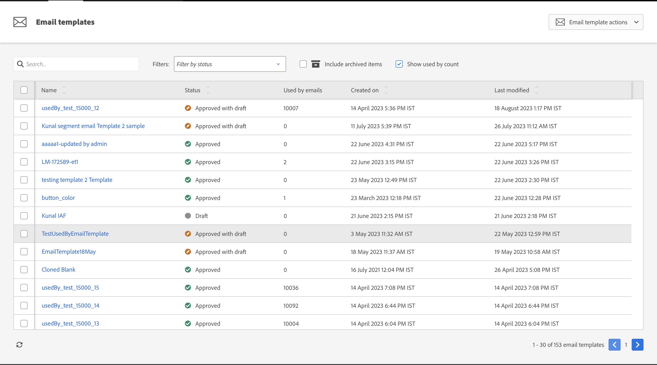
Modern UX: Used By Count Column for Design Studio List Views
Derive usage information of various assets in a single view to perform audits or analyze adoption of various Design Studio assets
Marketo Engage
Modern UX
Used By Count Column in Landing Page and Email Templates, Forms and Snippets to provide a glance of asset usage in List Views
  Used By Emails count column for Email Templates and Snippets as well as Used By Pages count column for Forms, Landing Page Templates and Snippets have been added to the List Views
  Separate checkbox "Show used by count" available to enable the column to improve load-time performance
  Option to sort in ascending and descending order is currently not available.

Slide 7
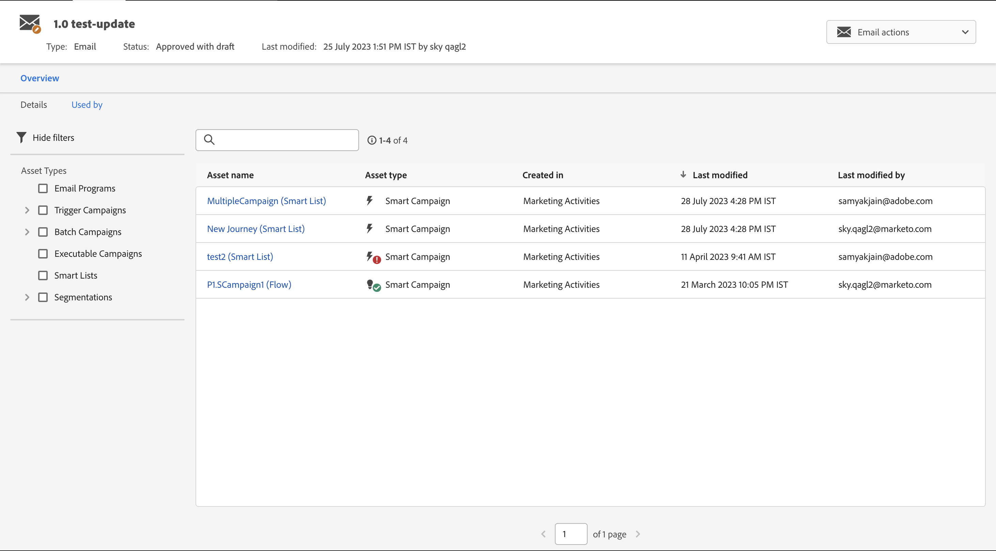
Modern UX: Used By Tab for Design Studio Details Views
Derive usage information of an individual asset in terms of details of other assets that are using this individual asset.
Marketo Engage
Modern UX
Used By Tab in Email as well as Images & Files Detail View to provide a glance of asset using the asset under consideration
  Used By Tab placed in the Overview menu besides the Details Tab to provide usage association of the asset under consideration.
  Hyperlinked asset name to navigate to the asset to uncover more details, if needed. Asset type helps to understand what type of asset uses the asset under consideration.
  Search and Filter option available to segregate the assets using the asset under consideration by asset types.

Slide 8
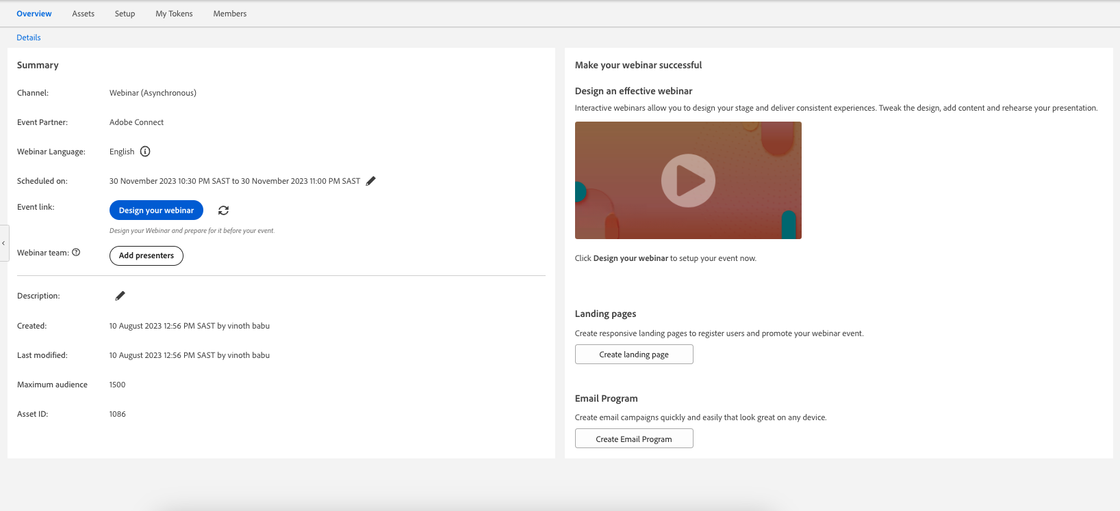
Interactive Webinars: Localization
Access Interactive Webinars' Marketo interface localized to the language of the Interactive Webinar User separate from the Delivery Language of the webinar.
Interactive Webinars
Interactive Webinars language on Marketo and Adobe Connect interface separate and localized to all Marketo-supported languages.
  Interactive Webinar users can observe their Interactive Webinar Event Programs localized to their user language in the Account section in the Admin menu.
  The Webinar language, which is the delivery language may be different from the user account language. This is setup in the Adobe Connect interface of Interactive Webinars.
  The field "Webinar Language" indicates the language setup in the Adobe Connect interface for delivery. Default language would be the User Account language. Any change made in the language in Adobe Connect interface reflects in Marketo.

Slide 9
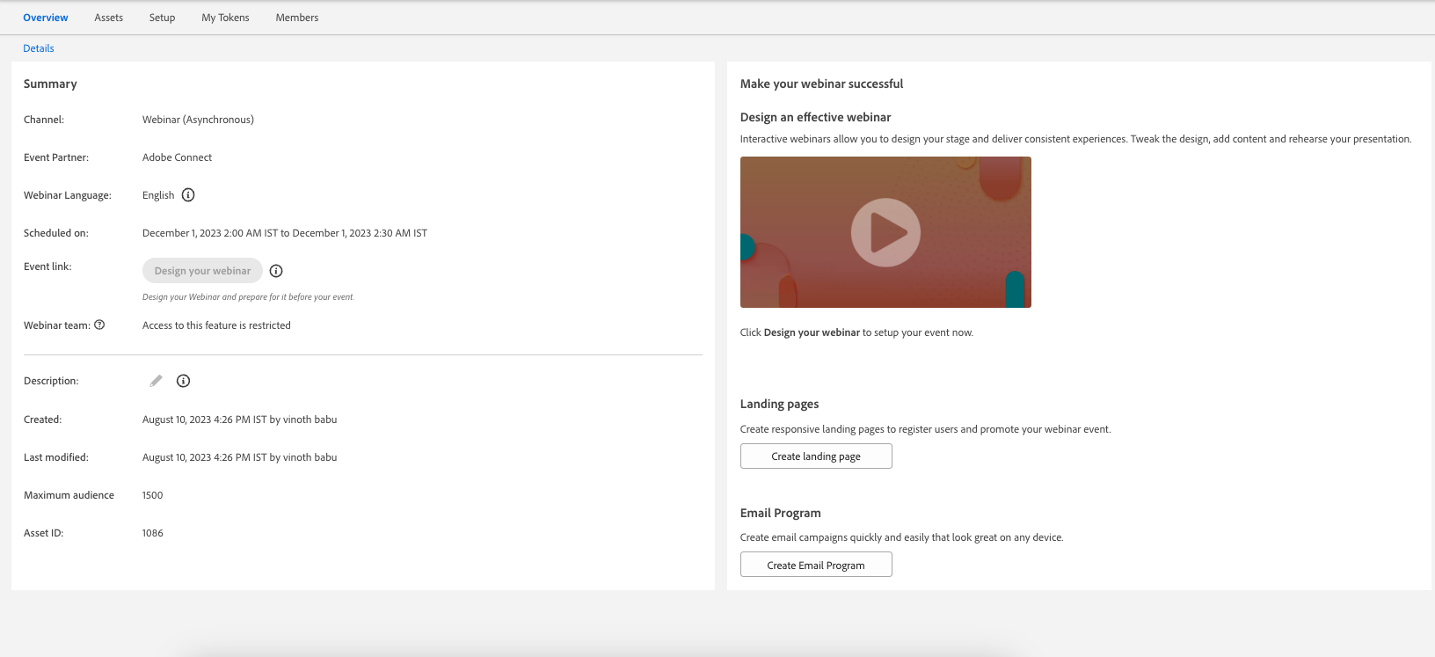
Interactive Webinars: User Access Management
Experience access management functionalities to regulate authorized access to Interactive Webinar Event Programs to ensure proper moderation of license usage.
Interactive Webinars
User Access Management allows access to Interactive Webinar Event Program created by the user in terms of delivery and moderation access to the Marketo Admin.
  Interactive Webinars' users will continue to have complete access on the programs they have created. However, access to other's Interactive Webinar Programs would be restricted to non-Admin users (except View access).
  Marketo Admin users who are also Interactive Webinars' users will continue to have complete access to own and other's Interactive Webinar Event Programs.
  Different access criteria would be applicable for users who have been removed as Interactive Webinars' users or have been re-added after having been removed.

Slide 10


Marketo Program Import Library
Lopa Padia
Product Manager

Slide 11
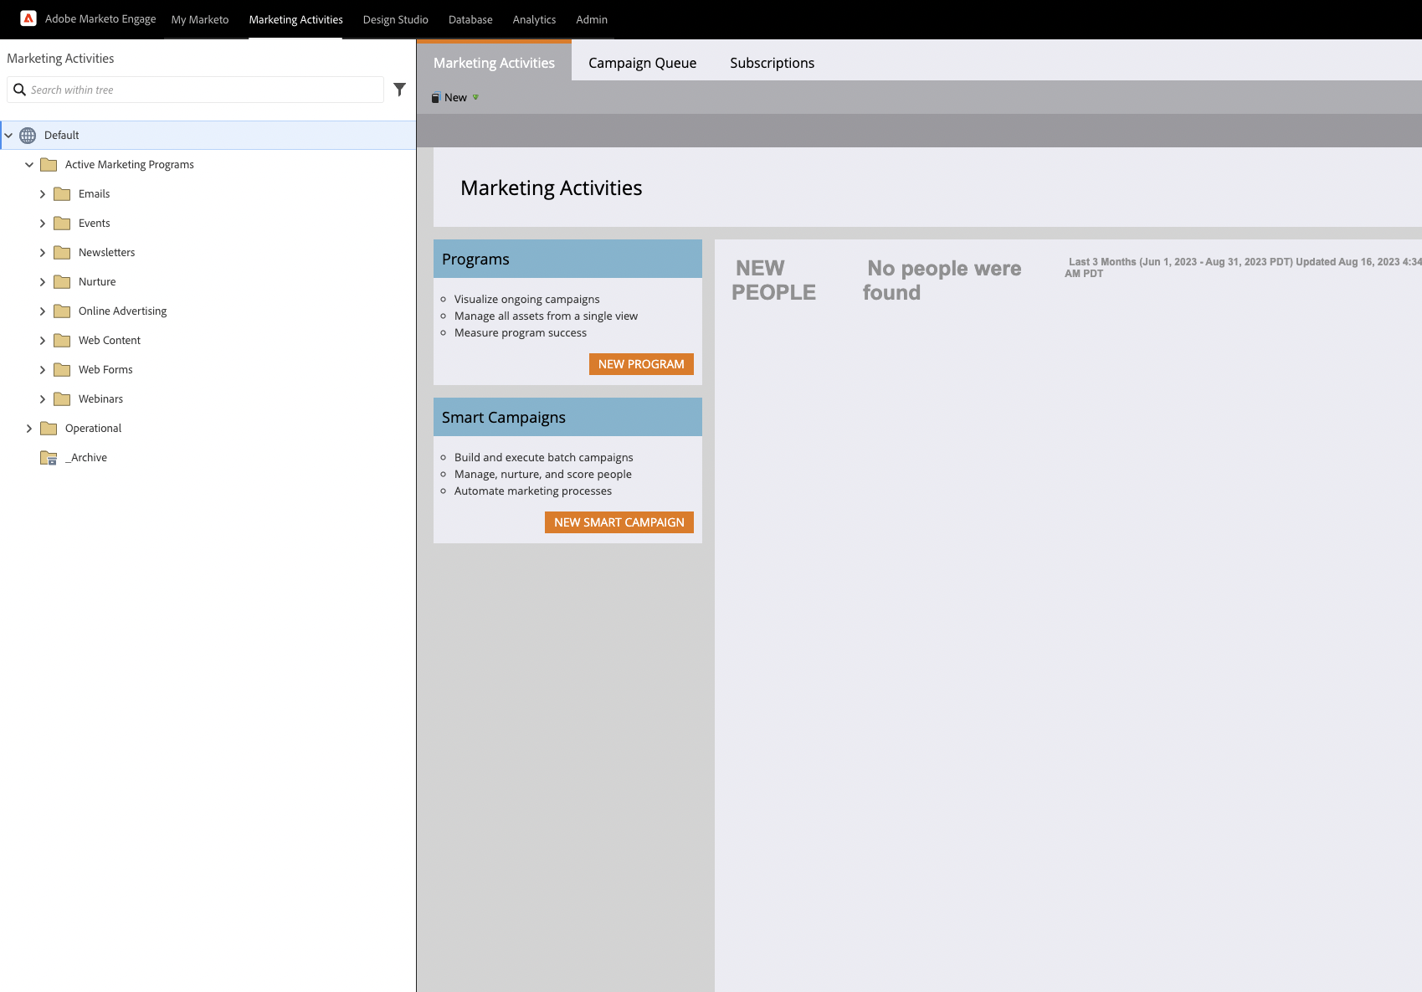
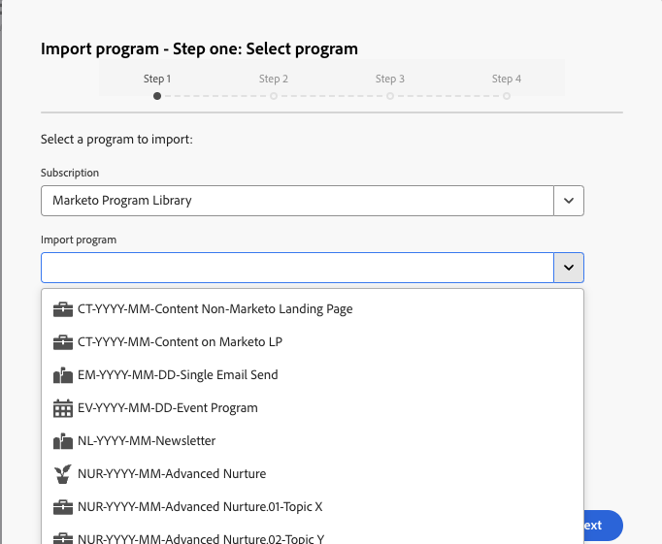
Program Library
Access to new and updated example starter programs to import into your instance
Marketo Program Import Library
Import best practice example starter programs at your fingertip
Responsive creative templates for email & landing pages
Example starter programs covering common marketing tactics
Streamlined workflow and program statuses that align with best practices
Best practice operational example programs covering lead scoring / data management / deliverability topics
Detailed documentation & guide for each example program on Experience League
Notes:
Hello, my name is Lopa and I'm the product manager for Marketo Engage. I'm here to share an exciting update about the Program Library that's connected to your Marketo instance. We've refreshed the program library to give you access to new and updated example starter programs to import into your instance. This includes responsive creative templates for email and landing pages, example starter programs with streamlined workflow covering common marketing tactics, and best practice operational programs covering lead scoring / data management, and deliverability topics. Each example program comes with detailed documentation & guide on Experience League to help you get started with your marketing activities!

Slide 12


Dynamic Chat
John Dictson
Senior Product Manager

Slide 13





Adobe Dynamic Chat offers multiple ways to have conversations with your modern-day B2B buyers
Dynamic Chat
Automated Chat
Live Chat
Conversational Flows
Generative Chat
ALPHA
2-way conversation between website visitor and chat bot using pre-defined dialogues powered by decision-tree logic
Freeform 2-way conversation between website visitors and live sales agents
Lead generation forms embedded on web, landing pages, emails and more that prompt customers with content and actions to take in the moment without needing a chat bot
Freeform 2-way conversation between website visitors and a chat bot powered by generative AI that has been trained with sales, marketing and product knowledge
Great for:
Prompting topics, addressing FAQs and allowing quick meeting bookings
Awareness for content, products / pages / event registration
Re-directing site traffic to low traffic pages, and collecting additional contextual data for lead scoring
Great for:
Sales BDR teams wanting a selective and conservative approach to using sales resources
Ensuring you’re always talking to hand-raisers
Offering after form fill or during automated chat conversation
Great for:
Making your forms and landing pages less static
Qualify and booking meetings without needing a chat bot module
Qualifying customers before offering live chat
Great for:
Maximizing self-serve experience for customers (ex: conversational search engine for your website)
Building immediate trust with customers through a natural, organic, fun and VERY intelligent experience
Sales Meeting Bookings | Lead/Account Qualification | Self-serve Experience
Notes:
Intro: Dynamic chat offers multiple ways to relate to your modern day B2B buyer
With Adobe Dynamic Chat you can…
Use automated chat which is great for prompting topics, addressing FAQs, drive awareness for events and redirecting site traffic to low traffic pages.
Use conversational forms to speed of the follow up and sales meeting booking process, powered by marketo engage forms you can easily qualify and book meetings without a chat bot
Use Live chat which is great for BDR teams to chat directly with the buyer and address questions early on. This ensures you are always talking to hand raisers
And lastly use generative chat to maximize this “self-serve” experience and help built immediate trust with customers through a natural and very intelligent experience.
Transition: All at no additional cost and with easy setup, you can do a lot with chat on your website

Slide 14
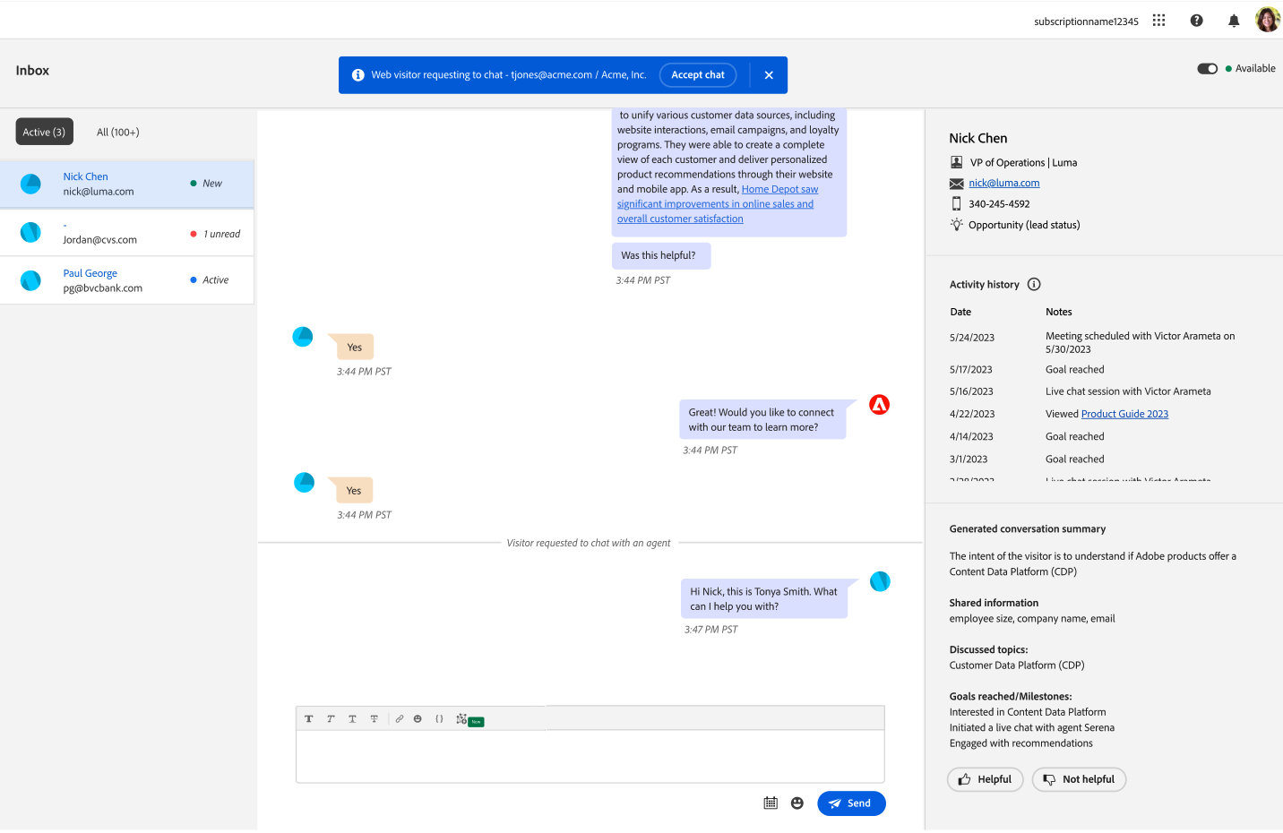
Dynamic Chat
Drive engagement and conversions with interactive, personalized conversations for every web visitor
Dynamic Chat
Features and enhancements coming in September
  Live chat & agent inbox
Smart list targeting
Global performance dashboards
Blocked email domains
  Target account routing
  Team management
  Action card
  Global fallback rules

Slide 15

Dynamic Chat
Steven Vanderberg
Senior Product Manager

Slide 16
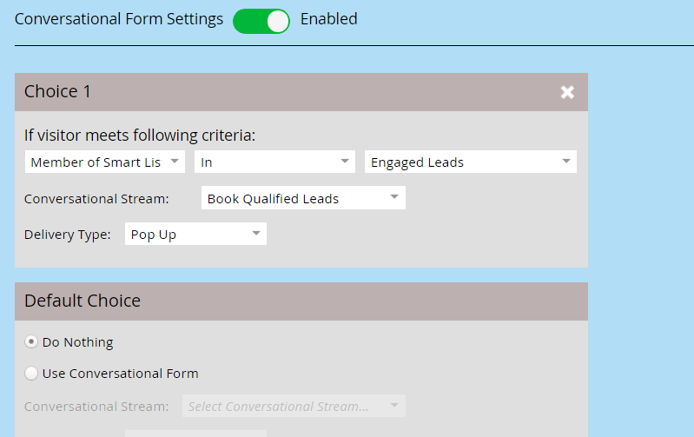
Conversational Forms
Turn your forms conversational and instantly qualify high value leads
Dynamic Chat
Offer more than a Thank You page!
  Follow up a Marketo Engage form submission with a Dynamic Chat Conversational Flow
  Qualify leads based on form field values or Smart List and Static List membership
  Instantly qualify for meeting bookings, offer white papers, capture additional lead info, and more!

Slide 17
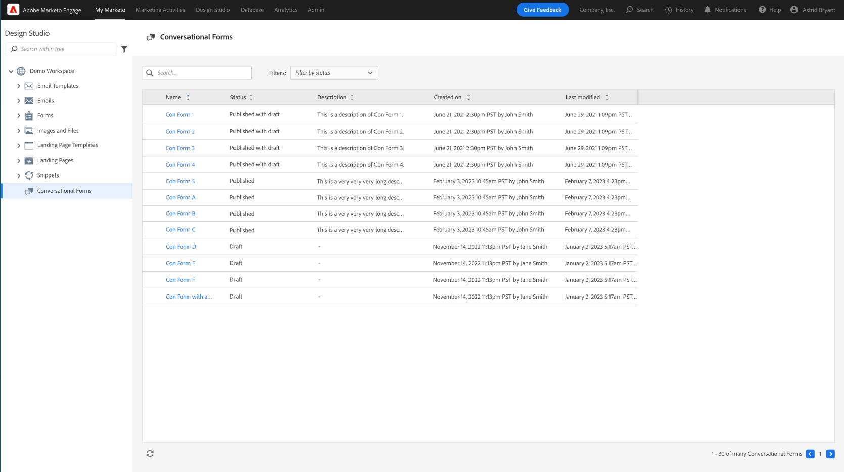
Conversational Flow Asset Page
A peek into Dynamic Chat
Dynamic Chat
See which Conversational Flows are available for integrating
  List view of available Conversational Flows
  Deep-link directly into Dynamic Chat to view or edit the Flow (appropriate permissions required)

Slide 18
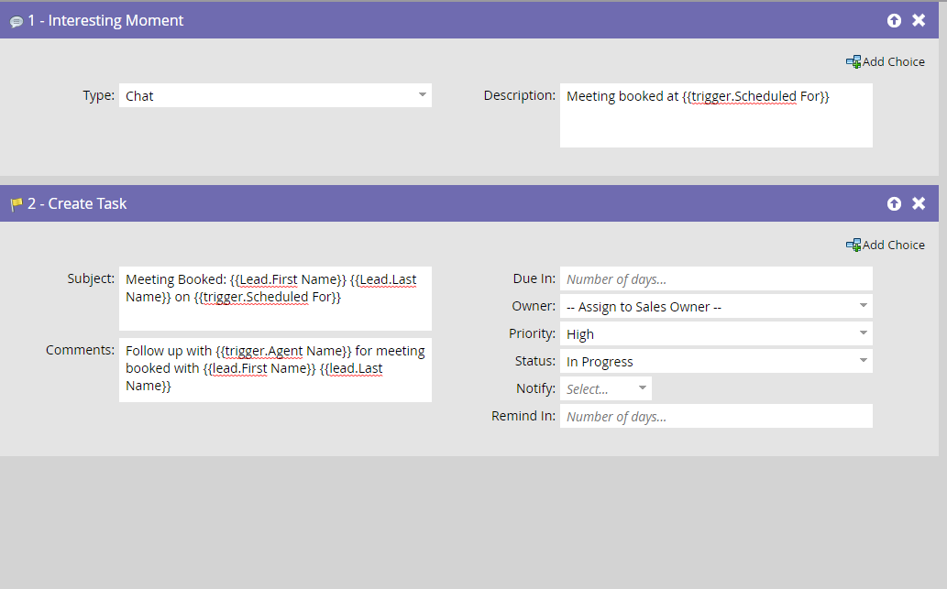
Dynamic Chat Activity Updates
Empower your Smart Campaigns with more activities and tokens
Dynamic Chat
Take full advantage of new touchpoints in Dynamic Chat
  New activities to target using added Dynamic Chat functionality
  New trigger tokens for Sales Alerts, Interesting Moments, and other Flow steps

Slide 19
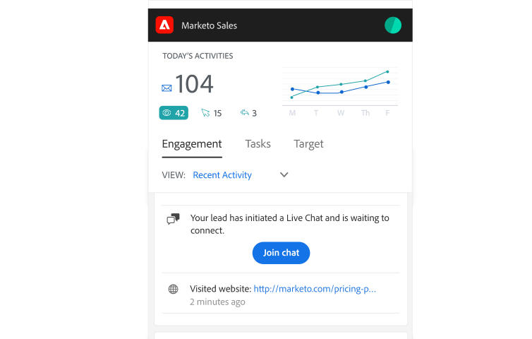
Sales Insight & Sales Insight Actions Updates
More insight into Dynamic Chat
Dynamic Chat
Support for Live Chat notifications and more activity attributes
  Receive notifications in Sales Insight Actions when a lead is waiting to live chat
  See more Dynamic Chat activity information in Sales Insight and the Sales Insight Actions Live Feed

Slide 20

Engagement Map
Tina Tseng
Product Manager

Slide 21

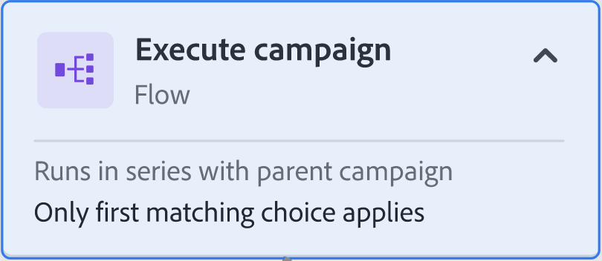
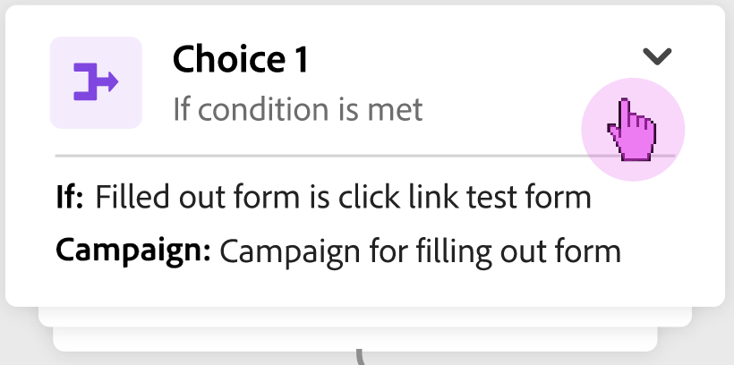
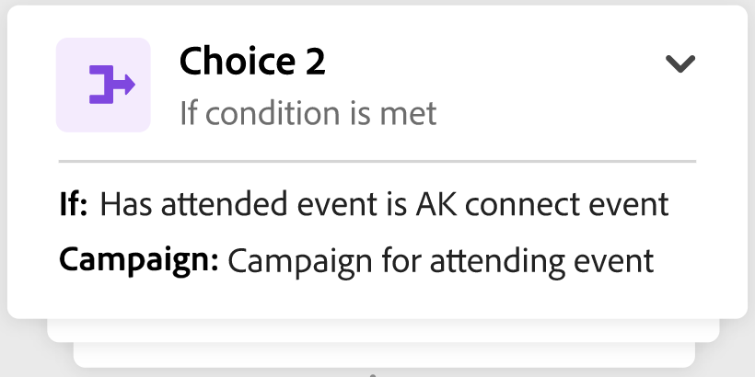
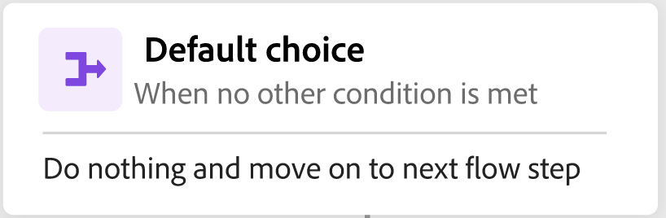


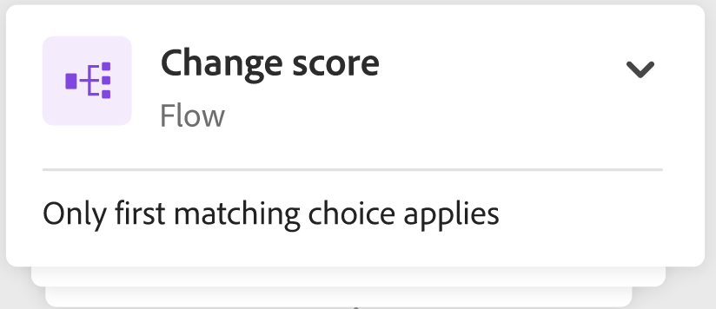

Engagement Map
Engagement Map
Increase velocity and efficiency with the new Engagement Map in Marketo Engage
Easily manage and validate interconnected campaigns with visualization
Increase operational efficiency with enhanced error handling and troubleshooting
Accelerate time to value by quickly onboarding new users
Improve alignment across key stakeholders with intuitive visuals that provide insight into complex campaigns
New Users
Power Users
Decision Makers

Slide 22



…and here’s what you can do with Engagement Map
Out of the box visuals
Workflow auditability
Campaign settings
Export and share
Simplifying workflows
Troubleshooting across an entire journey
Quick overview of campaign settings
Intuitive navigation
“Engagement Map” button gives you detailed visualization of your smart campaign
Visualization of interconnected campaigns helps with quickly deducing root cause of errors
One-stop-shop with all your campaign settings where you can set up recurrence and schedule campaigns
User-friendly design offers easy access to smart list, flow actions, campaign members, export and share

Slide 23


Sales Insight Actions
Andy Paul
Senior Product Manager

Slide 24
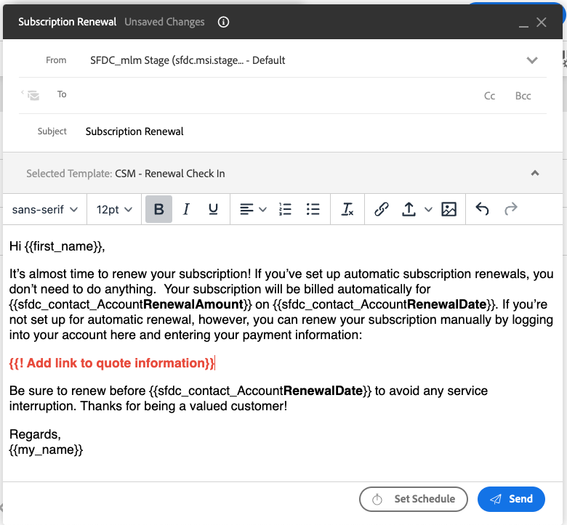
Sales Insight Actions Updates
Email personalization that drives conversions
Sales Insight Actions
Default Dynamic Fields and Prompts
  Prompt sales to customize specific parts of an email before it is sent out to ensure deep personalization is added to sales communication with the new Dynamic Field Prompt capability.
  Ensure that no Dynamic Field is left unpopulated in your emails, with the new Default Dynamic Field. This allows users to configure a fallback value to resolve to for a dynamic field, so that if no value can be populated the email can still go out with value added.

Slide 25


Marketo Measure
Brian Shin
Senior Product Manager

Slide 26
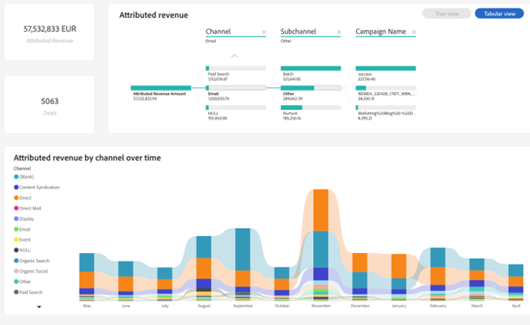
Marketo Measure In-app Reporting Enhancements
Marketo Measure
Attribution insights to drive marketing optimization
Rolling out to all Marketo Measure customers over the next 3 months
  A new and improved set of "out of the box" Discover Dashboards that are more powerful and easier to use and available to all Marketo Measure customers
  New calculated metrics including Realized ROI and Attribution Coverage
  Of course, you can still report on Marketo Measure insights in your CRM or with a BI tool. It's just that now you have a more powerful in-app option
  Coming soon in a subsequent release:
  In-app custom reporting

Slide 27
Q&A

